Slide 1
Responsive Web Design
Eng/Ryhab farouq

Slide 2
Grid System

Slide 3
Grid System CSS
Two dimensional layout model .
CSS Grid will allow you to manage layout according to both columns and rows.
Flexbox, by comparison, is really just meant for columns (1-D, if you will). Using CSS Grid, designers will be able to achieve layouts that were downright difficult before. In fact, some of these things were on our wish lists since the days of table-based layouts.

Slide 4
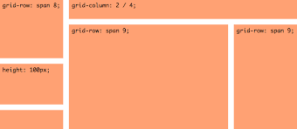
2-D Layout

Slide 5
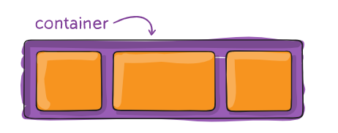
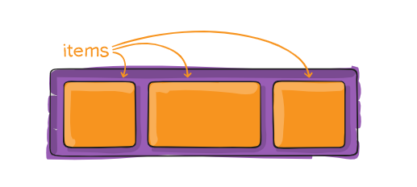
Terminology
container
items

Slide 6
Two Ways to implement Grid in CSS
Way_one
Grid-template-columns
Grid-template-rows
Grid-column : start/end
Grid-row : start/end

Slide 7
Two Ways to implement Grid in CSS
Way_two
Grid-template-areas
Grid-area

Slide 8
Media Queries

Slide 9
Media Queries
Tell the browser how to style an element at particular viewport dimensions
Types :
all
Screen
Print
Speech

Slide 10
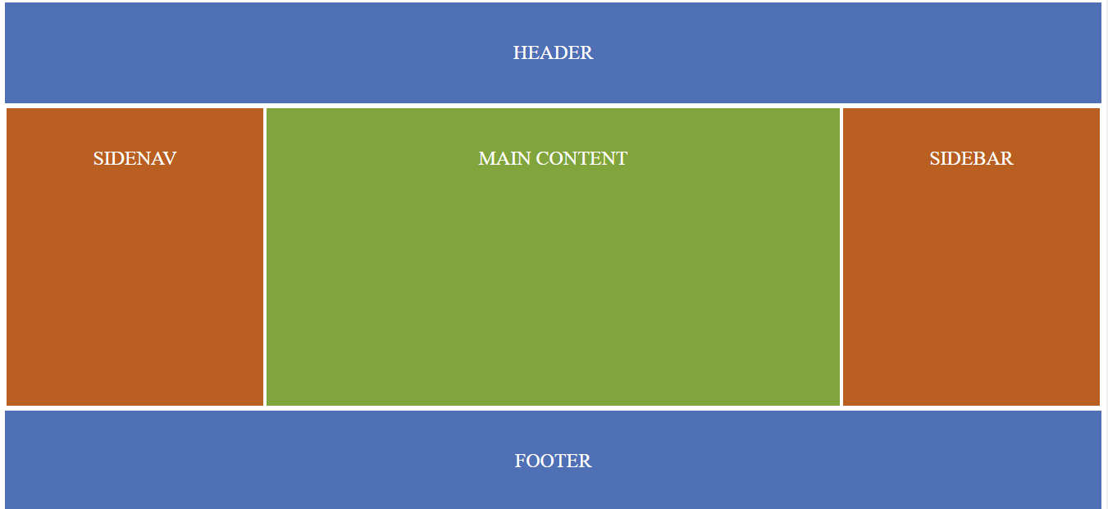
Task_One

Slide 11
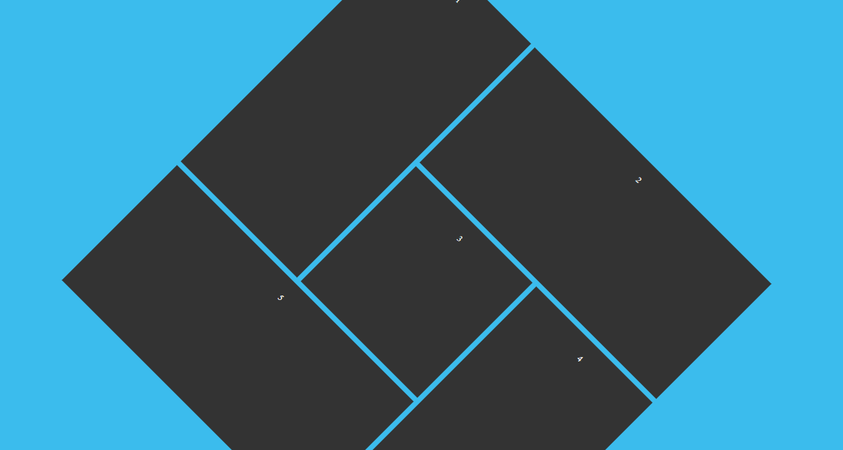
Task_Two

